Slide 1





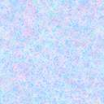



Whiteboardmaths.com
7
2
1
5
© 2004 All rights reserved

Slide 2
Isometric Drawing
Try drawing the simple shapes shown on triangular spotty paper or from the points indicated onto the whiteboard.
Getting Started

Slide 3
Polyominoids
Ominoid
Dominoid
Trominoids
Tetrominoids

